Slide 2
Text Classification using Machine and Deep Learning Algorithms
May 13th, 2019

Slide 3
Agenda
Text Classification
Definition of Machine Learning and Deep Learning
Dataset for Text Classification
Data Cleaning
Data Preparation (Word Embeddings)
Data Partition
Machine Learning Algorithms
Deep Learning Algorithm

Slide 4
Text Classification
Text classification is the process of assigning tags or categories to text according to its content. It’s one of the fundamental tasks in Natural Language Processing (NLP) with broad applications such as sentiment analysis, spam detection, and intent detection. a.k.a. text Categorization or text tagging. It can be done in 2 different ways:
Manual classification
Automatic Classification
Automatic can be further divide in to three types:
Rule Based
Machine Learning based
Hybrid (Rule + Machine)

Slide 5
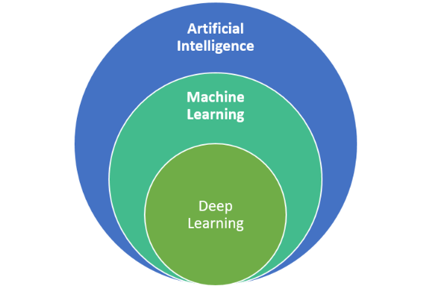
Definition
Machine learning is an application of artificial intelligence (AI) that provides systems the ability to automatically learn and improve from experience without being explicitly programmed. Machine learning focuses on the development of computer programs that can access data and use it learn for themselves. Two Types:
Supervised
UnSupervised
Deep learning is an artificial intelligence function that imitates the workings of the human brain in processing data and creating patterns for use in decision making. Deep learning is a subset of machine learning in artificial intelligence (AI) that has networks capable of learning unsupervised from data that is unstructured or unlabeled. Also known as deep neural learning or deep neural network.

Slide 6
Nestle Consumer Engagement Data (Dummy Data)
Consumers’ calls, emails and social media feeds categorized into labels:
Query
Complaint
Feedback

Slide 7

Data Cleaning
Remove the following:
Control Characters
Xml tags
Decode url encoded chars
Remove operators such as ‘<’ (less than), ‘>’ (greater than)
References
Xhtml tags
Normal url, preserve visible text
Image links, preserve caption
Trim white space- right & Left
Links to other languages
Wiki url, preserve visible text
{{icons}} {tables}
Remove stop words, punctuations,
Lemmatize, Stemming

Slide 8

Data Preparation
Corpus Formation
Document term Matrix
Tfidf matrix (Term Frequency- Inverse Document Frequency
TF = (Number of times term t appears in a document)/(Number of terms in the document)
IDF = log(N/n), where, N is the number of documents and n is the number of documents a term t has appeared in.
Remove Empty Rows
Bind Labels with the Matrix
Save the dataset

Slide 9
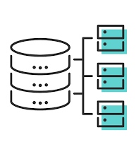
Data Partition
Training Data 70%
Validation/ Test 30%
It is essential to check that proportions are equal across Prepared Data sets.
Each label must have same proportion in Training and validation Data.

Slide 10
Machine Learning Models

Slide 11
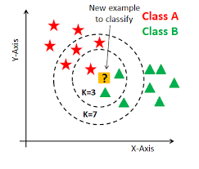
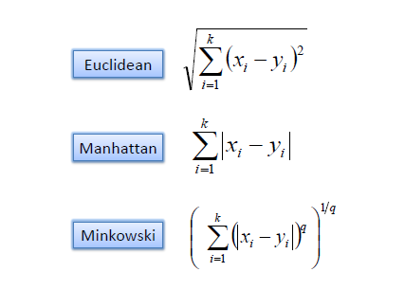
To begin with, k can be initialized as Sqaure Root of Total No. of Observation. K= (n)^1/2 Decide the distance Measure Training and Test datasets are fed into the algorithm simultaneously.
K-Nearest Neighbor

Slide 12
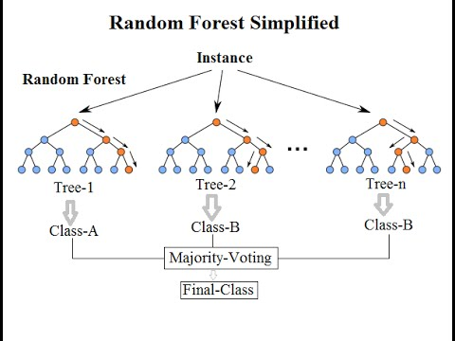

Random Forests classifiers are trained via the bagging method. Bagging or Bootstrap Aggregating, consists of randomly sampling subsets of the training data, fitting a model to these smaller data sets, and aggregating the predictions we are using “Entropy” which is measure of disorder. Information Gain is a metric to measure the reduction of this disorder
Random Forest

Slide 13
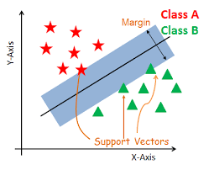
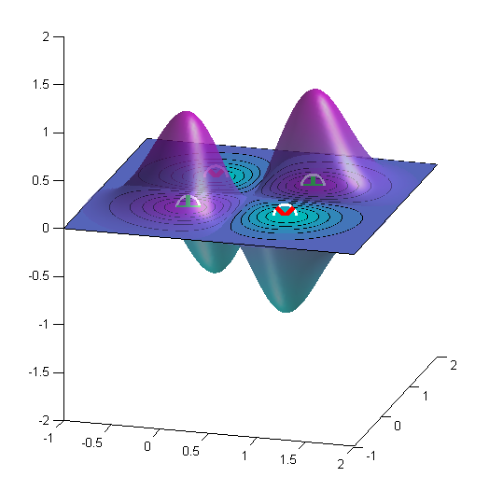
Support Vector Machine is responsible for finding the decision boundary to separate different classes and maximize the margin. Margins are the (perpendicular) distances between the line and the stars and triangles are lying on the edge of the Hyperplane are called Support Vectors. Hyperplane is an (n minus 1)-dimensional subspace for an n-dimensional space. For a 2-dimension space, its hyperplane will be 1-dimension, which is just a line. For a 3-dimension space, its hyperplane will be 2-dimension. Kernel used is “Radial” which creates a Hyperplane in Multi-dimensions and then separate the classes. Gaussian Radial Basis Function is most commonly used.
Support Vector Machines

Slide 14
Deep Learning Model

Slide 15
FastText is an open-source, free, lightweight library that allows users to learn text representations and text classifiers. All the label start by the “__label__” prefix, which is how fasttext recognize what is label and what is a word. For eg: __Label1__text……………………… Each word is broken down in to grams. For eg: “Different”:- Diff, iffe, ffe, eren, rent, erent.
FASTTEXT

Slide 16
Model Comparison: Accuracy and Computation Cost
Algorithm | Accuracy | Computation Cost
KNN | 0.7356 | 1.178149 hours
Random Forest | 0.8583 | 2.073023 hours
SVM | 0.8243 | 15.74909 mins
Fasttext | 0.8631 | 13.75627 secs

Slide 17
https://monkeylearn.com/text-classification/ https://towardsdatascience.com/entropy-how-decision-trees-make-decisions-2946b9c18c8 https://fasttext.cc/docs/en/supervised-tutorial.html https://www.analyticsvidhya.com/blog/2017/06/word-embeddings-count-word2veec/
Conclusion
We have learned the classic problem in NLP, text classification. We learned about important concepts like bag of words, TF-IDF and 3 ML algorithms KNN, Random Forest and SVM.
we have a brief overview of how to use fastText to train powerful text classifiers. We had a light overview of some of the most important options to tune.
Sometimes, if we have enough data set, choice of algorithm can make hardly any difference.
Areas to Explore
POST: Part of Speech Tagging
NER: Name Entity Recognition
Additional Readings:

